Slide 1
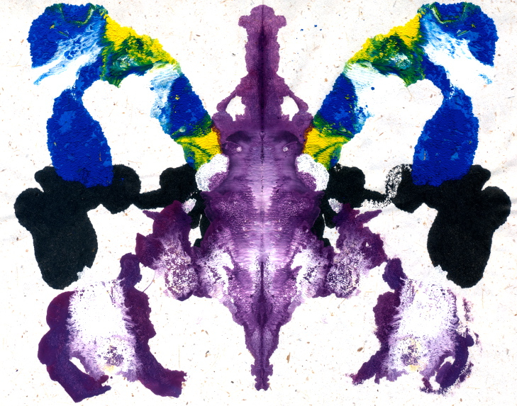
EVERYTHING in our life is about interpretations
Amir Dirin
https://www.youtube.com/watch?v=LKOq3Dhcqig

Slide 2
Human visual system
Nearly 70 percent of all the sensory receptors in your whole body are in the eyes
Vision is the dominant sensor
Light is electromagnetic radiation traveling in waves
Sound: High pitch (FREQUENCY) Light: determine hue -> low freq= blue high freq.= red
Sound: High volume (AMPLITUDE) light: relates to the brightness which red (high freq. appear to dual)
https://www.youtube.com/watch?v=EskTnxBoPoI&ebc=ANyPxKqBE728n7Ip2xYaPevpZLRrGjel8K0DRAaW4TECQv-f_qW5tKCzzx_MqlI4jv3XKn0f-C8DV5xPOpnIhxu5y2m2NNNWVw

Slide 3
Alzheimer's' eye test
Count every "F"' letter in the following text:
FINISHED FILES ARE THE RE SULT OF YEARS OF SCIENTI FIC STUDY COMBINED WITH THE EXPERIENCE OF YEARS...
http://www.dailycognition.com/index.php/2008/08/13/7-illusions-illustrating-how-powerful-stupid-your-mind-can-be.html

Slide 4
The brain cannot process 'OF'.
http://www.dailycognition.com/index.php/2008/08/13/7-illusions-illustrating-how-powerful-stupid-your-mind-can-be.html

Slide 5
Read
" Olny srmat poelpe can raed tihs.
I cdnuolt blveiee taht I cluod aulaclty uesdnatnrd waht I was rdanieg.
The phaonmneal pweor of the hmuan mnid, aoccdrnig to a rscheearch at Cmabrigde Uinervtisy, it deosn't mttaer in waht oredr the ltteers in a wrod are, the olny iprmoatnt tihng is taht the frist and lsat ltteer be in the rghit pclae.
The rset can be a taotl mses and you can sitll raed it wouthit a porbelm.
Tihs is bcuseae the huamn mnid deos not raed ervey lteter by istlef, but the wrod as a wlohe.
Amzanig huh? Yaeh and I awlyas tghuhot slpeling was ipmorantt! if you can raed tihs psas it on !! "
http://www.dailycognition.com/index.php/2008/08/13/7-illusions-illustrating-how-powerful-stupid-your-mind-can-be.html

Slide 6

Read out loud the text
http://www.dailycognition.com/index.php/2008/08/13/7-illusions-illustrating-how-powerful-stupid-your-mind-can-be.html

Slide 7
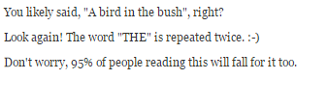
http://www.dailycognition.com/index.php/2008/08/13/7-illusions-illustrating-how-powerful-stupid-your-mind-can-be.html

Slide 8

What do you see
http://www.dailycognition.com/index.php/2008/08/13/7-illusions-illustrating-how-powerful-stupid-your-mind-can-be.html

Slide 9
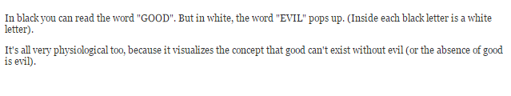
http://www.dailycognition.com/index.php/2008/08/13/7-illusions-illustrating-how-powerful-stupid-your-mind-can-be.html

Slide 10

http://www.dailycognition.com/index.php/2008/08/13/7-illusions-illustrating-how-powerful-stupid-your-mind-can-be.html

Slide 11
Group activity
Analysis the following interface based on Glitz theory

Slide 12
